Slide 1
Supervised Learning I: Regression
Jiang Zhang
School of Systems Science
Beijing Normal University

Slide 2
Outline
Linear Regression
Basic notions
Recommender System

Slide 3
Outline
Linear Regression
Basic notions
Recommender System

Slide 4
Example: Linear Regression
Price
？
Time
2011 2012 2013 2014 2015 2016 2017 2018
此时的价格是多少？

Slide 5
Data
Price
Samples
？
Time
2011 2012 2013 2014 2015 2016 2017 2018
此时的价格是多少？

Slide 6
Prediction Model
Price
Model：y=0.5 t+1034
Time
2011 2012 2013 2014 2015 2016 2017 2018

Slide 7
Prediction Model
Price
Model：y=2.8 t - 10
Time
2011 2012 2013 2014 2015 2016 2017 2018

Slide 8
Prediction Model
Price
Model：y=a t+b
a,b：Parameters
Finding a best line (a,b) to fit all data
Time
2011 2012 2013 2014 2015 2016 2017 2018

Slide 9
Learning(training)
Price
y=a t+b
Judgment: Error(Vertical distances between samples and the line)
Finding a best line (a,b) such that the Error could be minimized
This process is Training or learning
Time
2011 2012 2013 2014 2015 2016 2017 2018

Slide 10
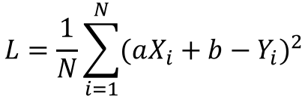
Mathematical Formulation
Minimize:
To obtain a*,b*
$$L=\frac{1}{N}\sum_{i=1}^{N}{{(aX_{i}+b−Y_{i})}^{2}}$$

Slide 11
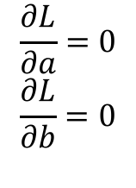
Solution
Minimize:
To obtain a*,b*
By solving:
$$L=\frac{1}{N}\sum_{i=1}^{N}{{(aX_{i}+b−Y_{i})}^{2}}$$
$$\frac{∂L}{∂a}=0$$
$$\frac{∂L}{∂b}=0$$

Slide 12
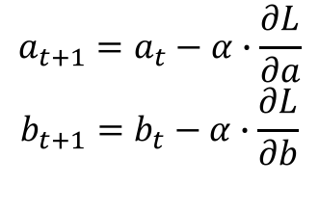
Solution
Minimize:
To obtain a*,b*
By Iterating:
$$L=\frac{1}{N}\sum_{i=1}^{N}{{(aX_{i}+b−Y_{i})}^{2}}$$
$$a_{t+1}=a_{t}−α∙\frac{∂L}{∂a}$$
$$b_{t+1}=b_{t}−α∙\frac{∂L}{∂b}$$

Slide 13
Gradient Descent
Minimize:
To obtain a*,b*
This is gradient descent algorithm:
$$L=\frac{1}{N}\sum_{i=1}^{N}{{(aX_{i}+b−Y_{i})}^{2}}$$
$$a_{t+1}=a_{t}−α∙\frac{∂L}{∂a}$$
$$b_{t+1}=b_{t}−α∙\frac{∂L}{∂b}$$

Slide 14
To Predict
Price
y=a t+b
After obtaining a*,b*, we insert t=2018 into y=a t+b to obtain the corresponding y^
Time
2011 2012 2013 2014 2015 2016 2017 2018

Slide 15
How to evaluate?
Training data
Testing data
To notice:
Similar distribution
Particular, same proportion for each label
Training:test
9:1~2:1

Slide 16
Evaluation
Price
y=a t+b
Compare the predicted price with the real price in the test data set to calculate the accuracy
This process is called Testing
Time
2011 2012 2013 2014 2015 2016 2017 2018

Slide 17
Important notions
Training – learning
Testing
Sample
Model
Objective function
Learning algorithm
Parameter
Hyper-parameter

Slide 18
More general case…
Price
Y=A sin(a x+b)
？
Time
2011 2012 2013 2014 2015 2016 2017 2018
What is the price in next year?

Slide 19
More general case…
Model: z=f(t,d)
To predict…

Slide 20
Outline
Linear Regression
Noise and model selection
Recommender System

Slide 21
Over-fitting

Slide 22
No noise
https://arxiv.org/abs/1803.08823

Slide 23
Over
fitting
https://arxiv.org/abs/1803.08823

Slide 24
How to get over over-fitting?
Reduce the model
Add more data
https://arxiv.org/abs/1803.08823

Slide 25
Bias variance trade-off
https://arxiv.org/abs/1803.08823

Slide 26
Bias variance trade-off
https://arxiv.org/abs/1803.08823

Slide 27
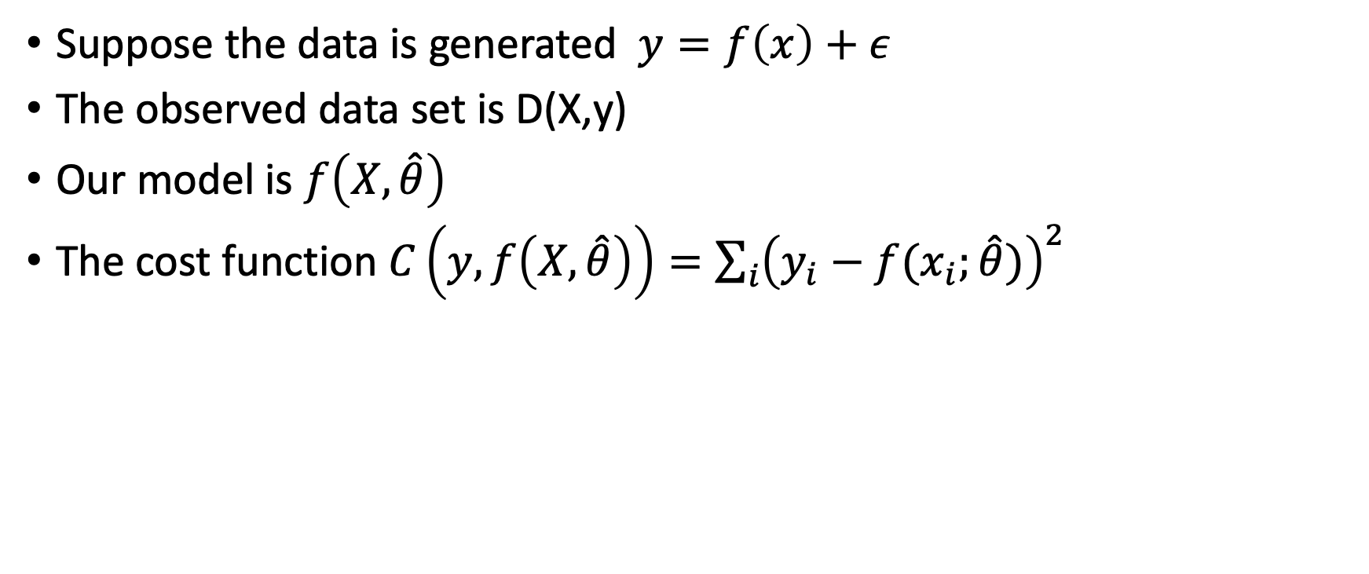
Bias Variance Decomposition
Suppose the data is generated $y=f\left(x\right)+ε$
The observed data set is D(X,y)
Our model is $f\left(X,\hat{θ}\right)$
The cost function $C\left(y,f\left(X,\hat{θ}\right)\right)=\sum_{i}{{\left(y_{i}−f(x_{i};\hat{θ})\right)}^{2}}$
https://arxiv.org/abs/1803.08823

Slide 28
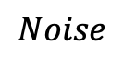
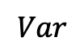
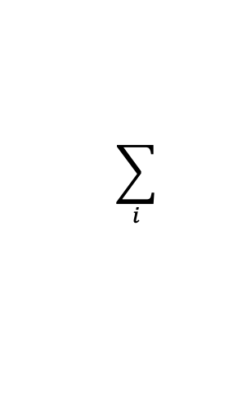
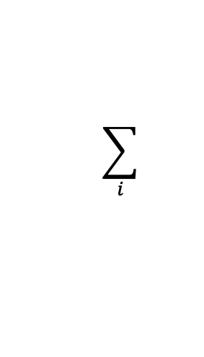
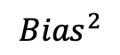

Bias Variance Decomposition
$$\sum_{i}{}$$
$$Noise$$
$$\sum_{i}{}$$
$$E_{out}={Bias}^{2}+Var+Noise$$
$${Bias}^{2}$$
$$Var$$
https://arxiv.org/abs/1803.08823

Slide 29
Outline
Linear Regression
Basic notions
Recommender System

Slide 30




Recommender Systems

Slide 31
What’s the problem?
 | A | B | C | D
Artificial Intelligence | 5 | 0 | ? | 5
Calculus | ? | ? | 1 | 5
Machine Learning | 4 | ? | 2 | 5
Angle and Ghost | 2 | 3 | 4 | 1
The Da Vinci’s code | 0 | 5 | ? | ?
Can we infer ?
Andrew Ng: Machine Learning, Cousera

Slide 32
Features
 | A | B | C | D
Artificial Intelligence | 5 | 0 | ? | 5
Calculus | ? | ? | 1 | 5
Machine Learning | 4 | ? | 2 | 5
Angle and Ghost | 2 | 3 | 4 | 1
The Da Vinci’s code | 0 | 5 | ? | ?
Knowledge | Fun
0.8 | 0.1
0.7 | 0.1
0.9 | 0.4
0.3 | 1
0.2 | 0.9
Can we infer ?
Andrew Ng: Machine Learning, Cousera

Slide 33
Variables
θ1
θ2
 | A | B | C | D
Artificial Intelligence | 5 | 0 | ? | 5
Calculus | ? | ? | 1 | 5
Machine Learning | 4 | ? | 2 | 5
Angle and Ghost | 2 | 3 | 4 | 1
The Da Vinci’s code | 0 | 5 | ? | ?
Knowledge | Fun
0.8 | 0.1
0.7 | 0.1
0.9 | 0.4
0.3 | 1
0.2 | 0.9
rij: rij=1 if user i rates book j, otherwise 0
yij: the rate of i to j, defined only if rij=1
n: total number of books
m: total number of users
L: number of features

Slide 34
Modeling users
θ1
θ2
θ3
θ4
x1
x2
x0=1
 | A | B | C | D
Artificial Intelligence | 5 | 0 | ? | 5
Calculus | ? | ? | 1 | 5
Machine Learning | 4 | ? | 2 | 5
Angle and Ghost | 2 | 3 | 4 | 1
The Da Vinci’s code | 0 | 5 | ? | ?
Knowledge | Fun
0.8 | 0.1
0.7 | 0.1
0.9 | 0.4
0.3 | 1
0.2 | 0.9

Slide 35
How to learn θ?
To minimize the following function
A vector that indicates the weights of user i on different features
The feature vector of the book j
A parameter of regularization (to avoid ridiculous infinity)
The rate of user i to book j
r(i,j): r(i,j)=1 if user i rates book j, otherwise 0

Slide 36
For all users
To minimize the following function
A vector that indicates the weights of user i on different features
The feature vector of the book j
A parameter of regularization (to avoid ridiculous infinity)
The rate of user i to book j
Notes:
When x is very small, theta can be infinity if lambda=0, for example, ck=()/(lambda+xk^2)

Slide 37
New Problem
However, how can we know x(j)?
If θ is given, then it is easy to guess x(j)
For example, if
Are given, how can we know x?
 | A
Artificial Intelligence | 5

Slide 38
Actually
We can minimize the following function to learn x(j):
For all books

Slide 39
Collaborative Filtering
Given x(1),x(2),…,x(n), to estimate θ(1), θ(2),…, θ(m),
Given θ(1), θ(2),…, θ(m), to estimate x(1),x(2),…,x(n)
X→ θ→X→ θ

Slide 40
Collaborative Filtering Algorithm
Actually, we can combine the two problems together
To minimize the following function

Slide 41
Collaborative Filtering Algorithm
Initialize x(1),..; θ(1),…
By gradient descent method
α: controls the rate of convergence

Slide 42
Inferring
Based on x, θ, we can infer each empty entries by calculating:
To recommend:
For book j, its feature vector is x(j)
Then search all books with feature x(k), such that |x(j)-x(k)|<r

Slide 43
Conclusion
We introduce the basic conceptions of machine learning
All these learning problems can be formulated as an optimization problem
Think problems like machine learning

Slide 44
Homework
Realize this algorithm
And Test the algorithm on the dataset of Netflix
Select partial data set
Separate training data, validation data, and test data (8:1:1)
Run the algorithm and test
Data download:
http://pan.baidu.com/s/1dDtmbW9

Slide 45
References
Sergios Theodoridis & Konstantinos Koutroumbas, Pattern Recognition, Elsevier, 2009
George F. Luger, Artificial intelligence, Pearson Education Limited, 2002
Ng Andrew: Machine learning (Cousera) https://www.coursera.org/course/ml

